Slide 1



Course Name- Internet & Web Programming (Project)
Course Code: CSE-3111
Done by team ‘digital dynamos’
“eventmie”
1

Slide 2
Guided by-
Dr. Sajeeb Saha
Associate professor
Dept. Of computer science and engineering
Jagannath University, Dhaka.
Presented by-
Najnin Sultana Shirin
ID: B190305031
&
Fahim Hasan
ID: B190305029
3rd Year 1st Semester
Dept. of Computer Science & Engineering,
Jagannath University, Dhaka
2

Slide 3
Introduction
Goals and Inspiration
Languages and Tools
Implementation
Screenshot
Farther Implementation
Table of contents
3

Slide 4

INTRODUCTION
An event management system web project is a digital platform that helps plan, organize, and promote events.
It offers features like user registration and login, event creation, event scheduling, contract system, payment system, and feedback collection.
Building an event management system web project involves a combination of design, development, and user experience considerations.
4

Slide 5
As beginners, we were motivated to learn everything about web development: from its real-world uses to the tools available. Our goal is to become skilled at crafting appealing websites and applications that work well and captivate users
Source of Inspiration
5

Slide 6
Front End: HTML, CSS, JavaScript Back End: PHP, MySQL
Server: XAMPP for Localhost
Operating System: Windows 10
Browser: Google Chrome / Microsoft Edge / Firefox Web Browser
Mail Server: gmail
Payment Gateway: SSLCOMMERZ
Payment script: php- tcpdf
Rating: ajex
USED TOOLS AND FRAMEWORKS
6

Slide 7


Users of the event management system
This project is used by 2 types of users:
1. Customer
2. Administrators (Management of the event)
Customers
Admin/Management
Can log in with a unique user id and email
Can check all kinds of event facilities
Can reserve EVENT
Get information about the EVENT and can give feedback about the event
Check details of the EVENT
CAN UPDATE THE UPCOMING PROGRAMME
Manage customers
Can Add more facilities
Can approve the booking
7

Slide 8
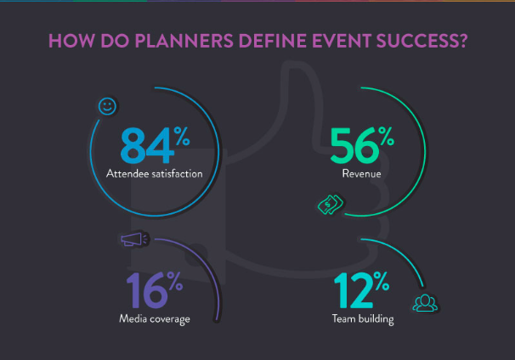
ADVANTAGES OF EVENT MANAGEMENT SYSTEM
Efficient Planning
Online Registration
Centralized Information
Automated Communication
Convenient Payment Processing
Less time consuming
Feedback Collection
Reduced Workload
8

Slide 9
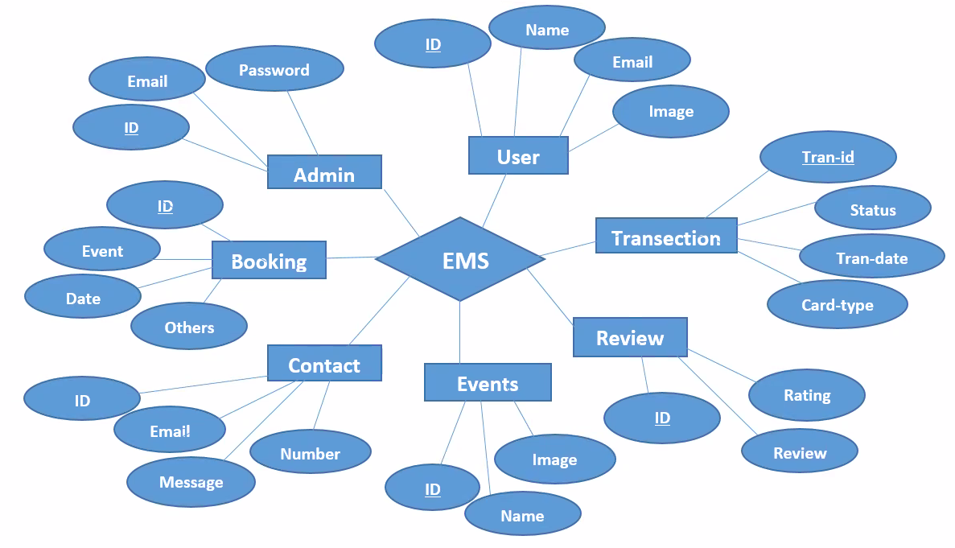
ER Diagram
9

Slide 10
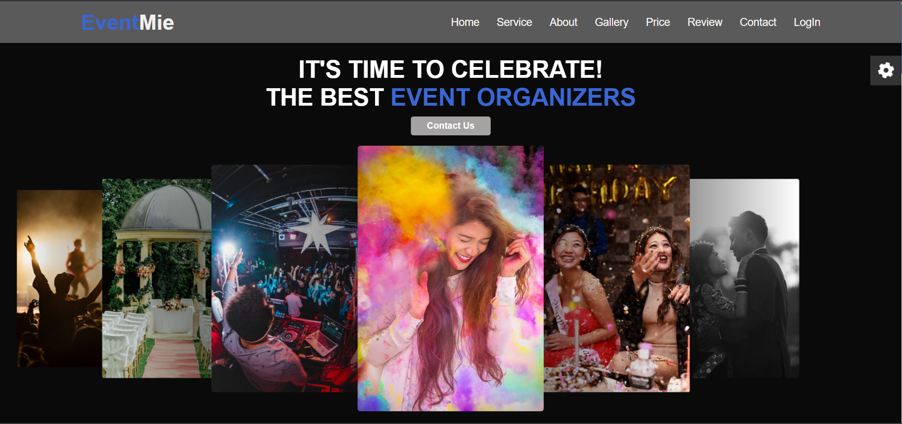
Home page
10

Slide 11
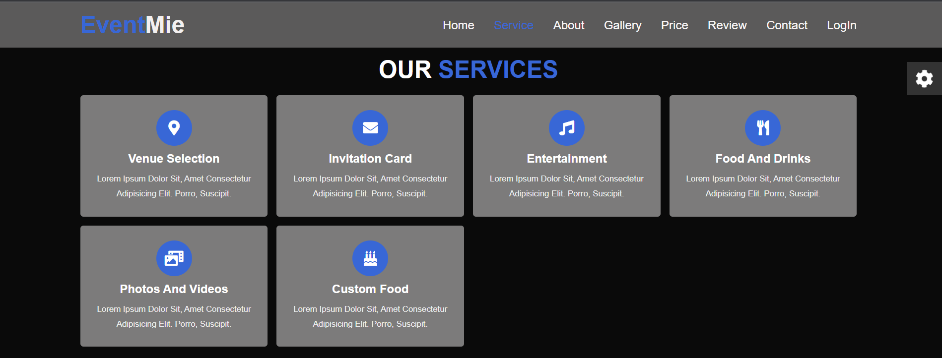
SERVICE
11

Slide 12

ABOUT
12

Slide 13
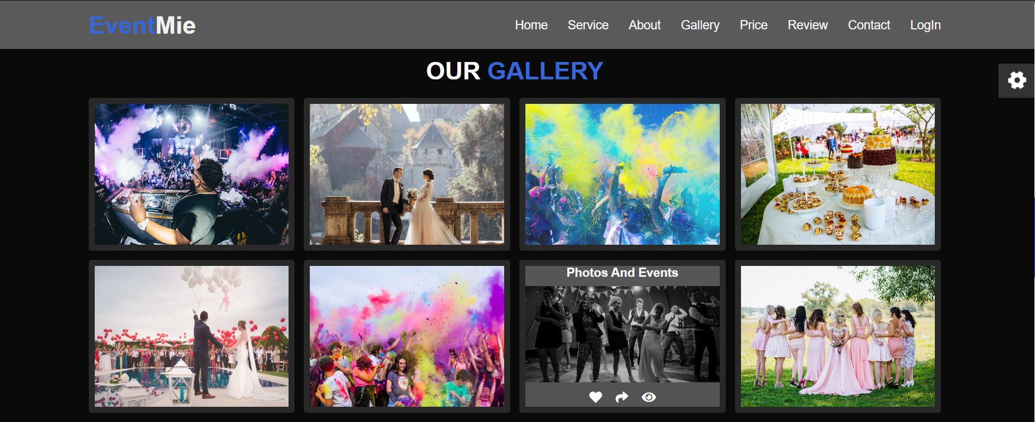
Gallery
1
12
13

Slide 14
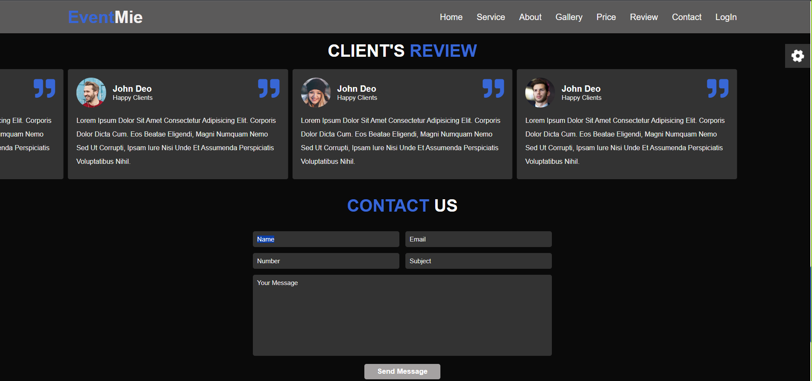
CLIENT’S REVIEW
14

Slide 15
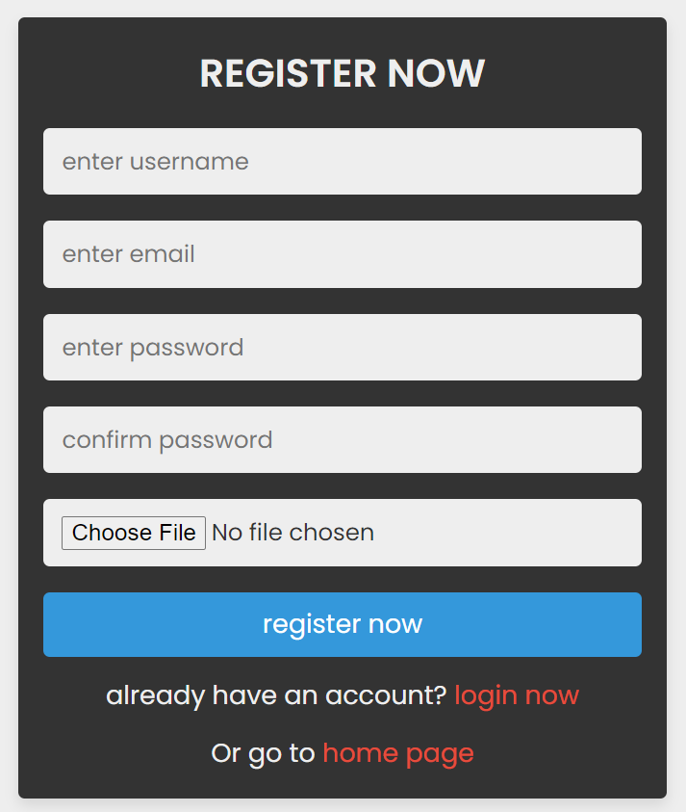
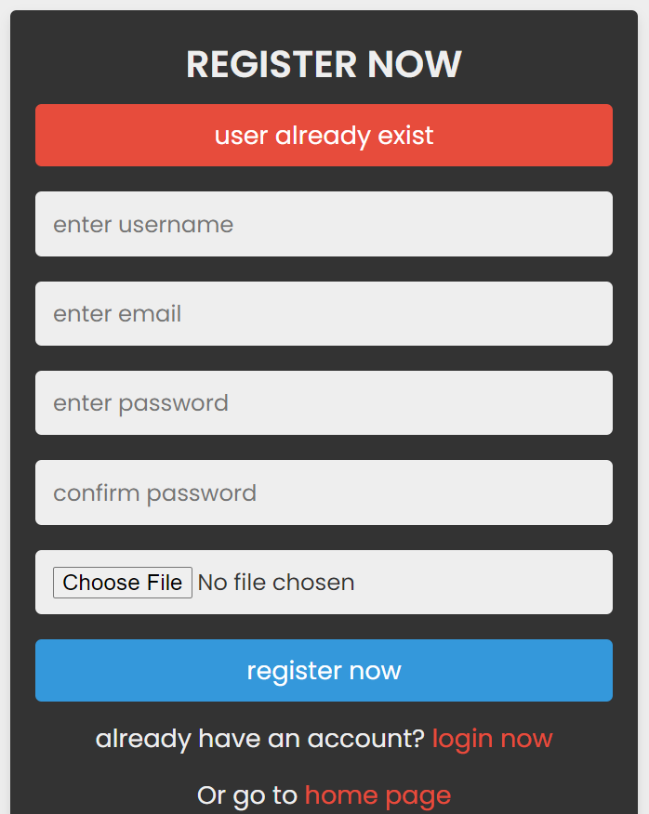
Registration
15

Slide 16
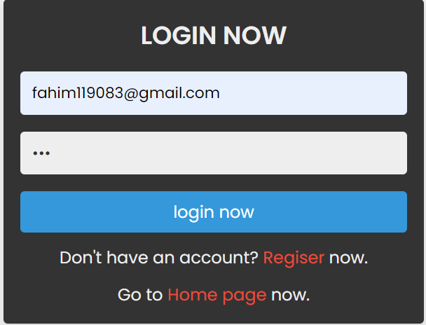
login
16

Slide 17
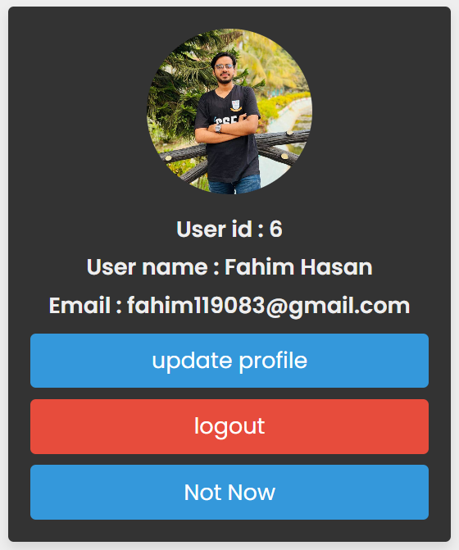
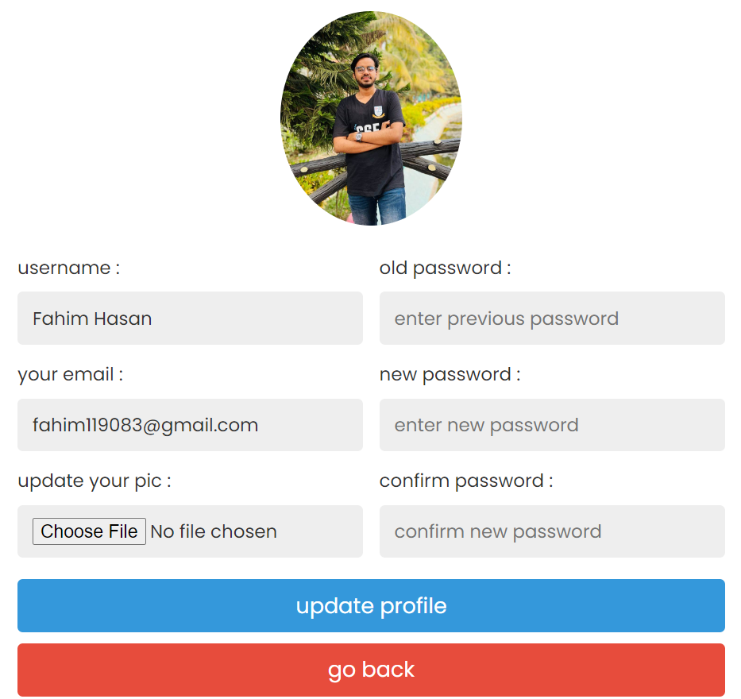
Profile and update profile
17

Slide 18
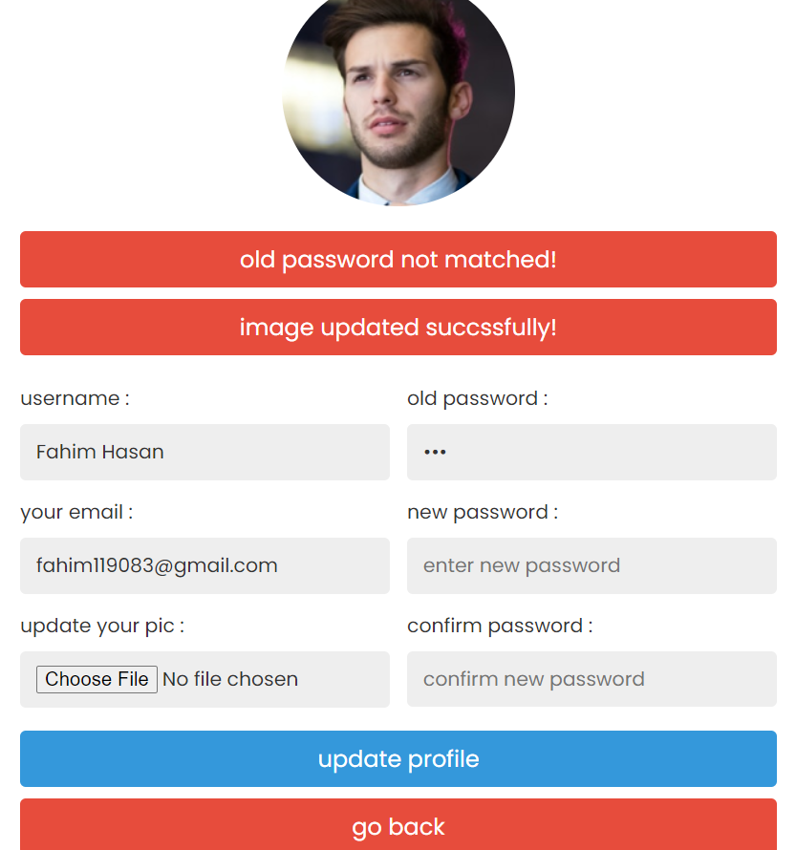
UPDATE PROFILE
18

Slide 19
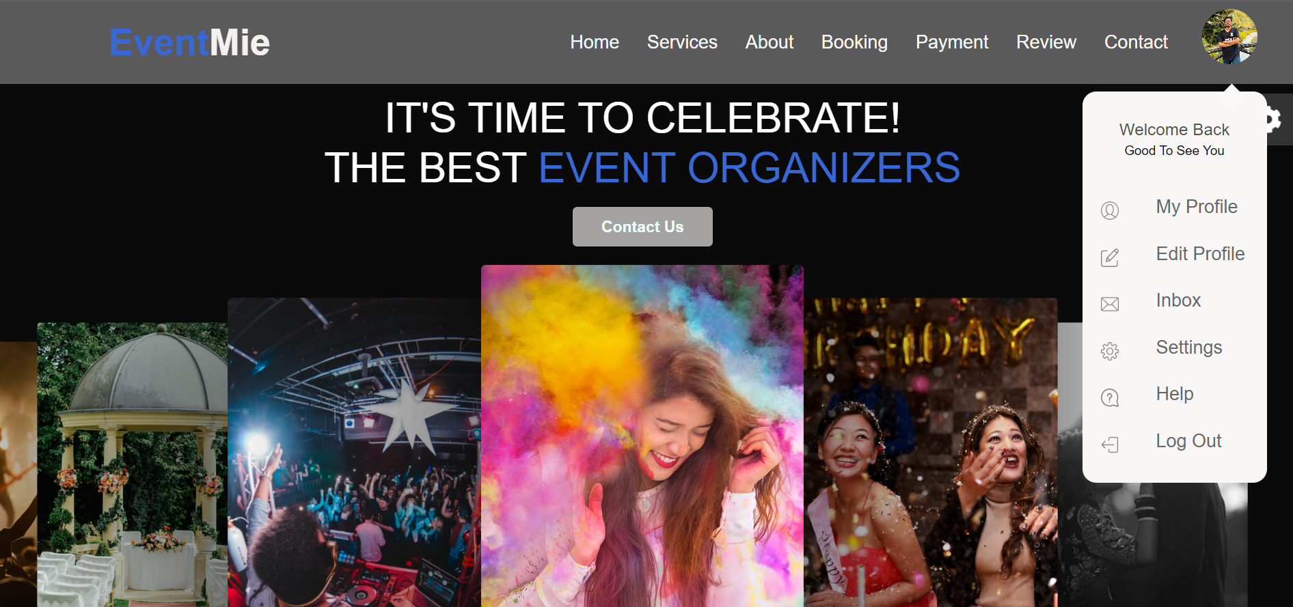
Landing page
19

Slide 20
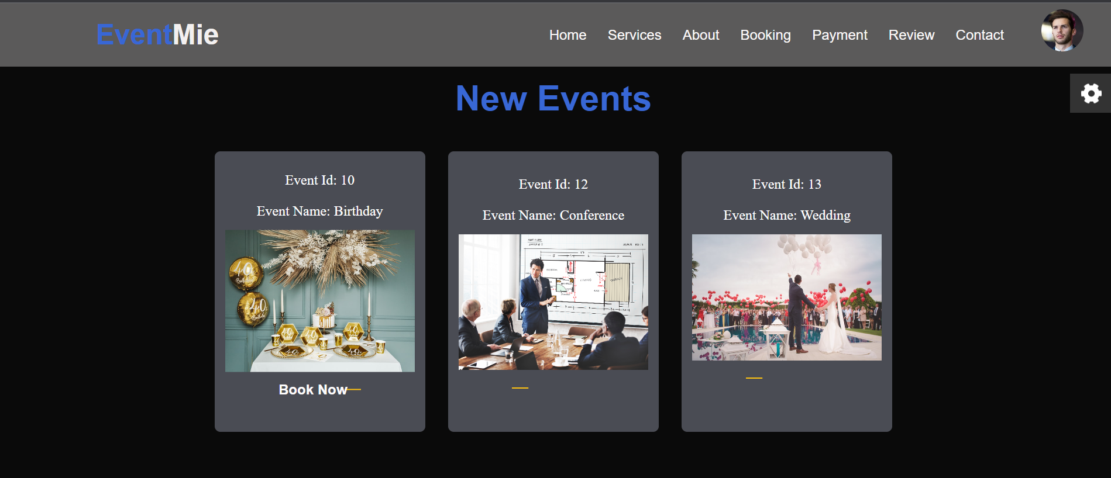
NEW EVENTS
20

Slide 21
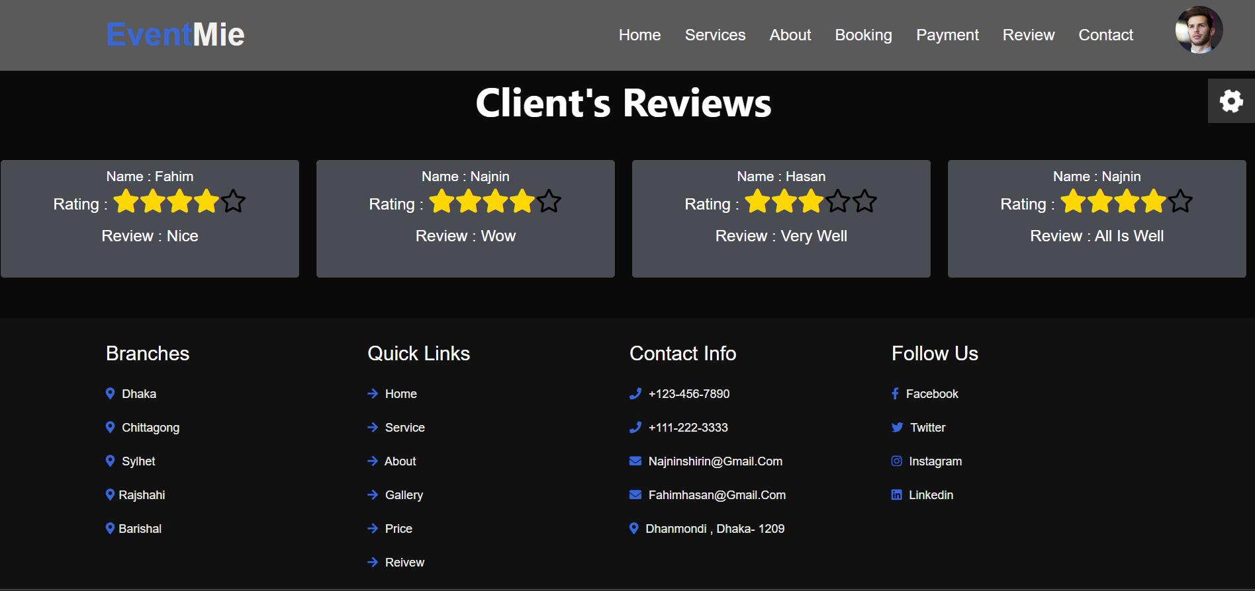
CLIENT’S REVIEW
21

Slide 22
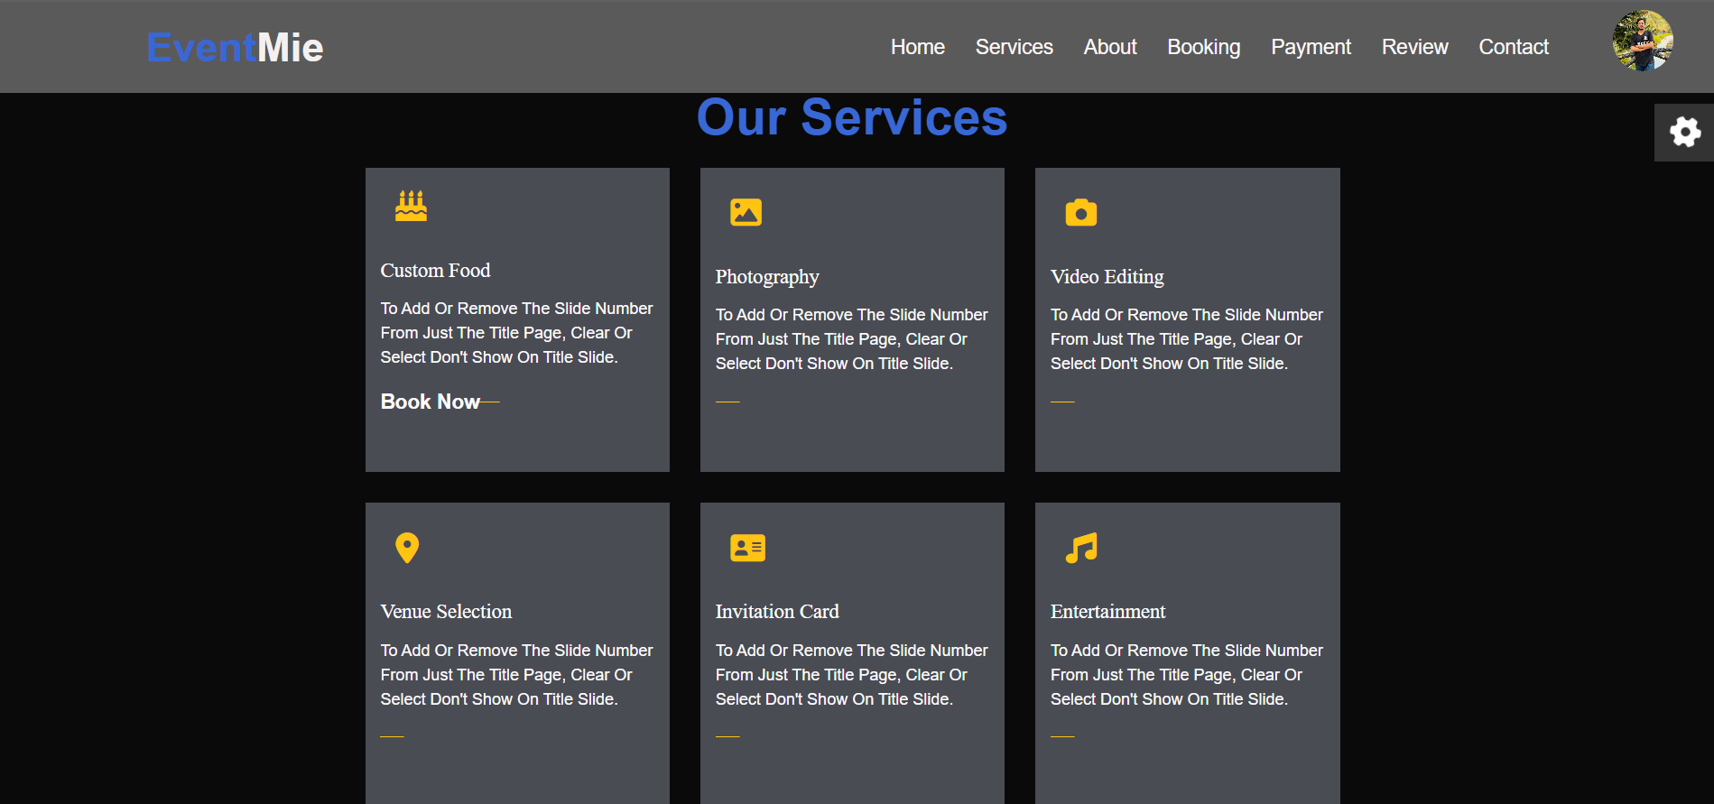
22

Slide 23
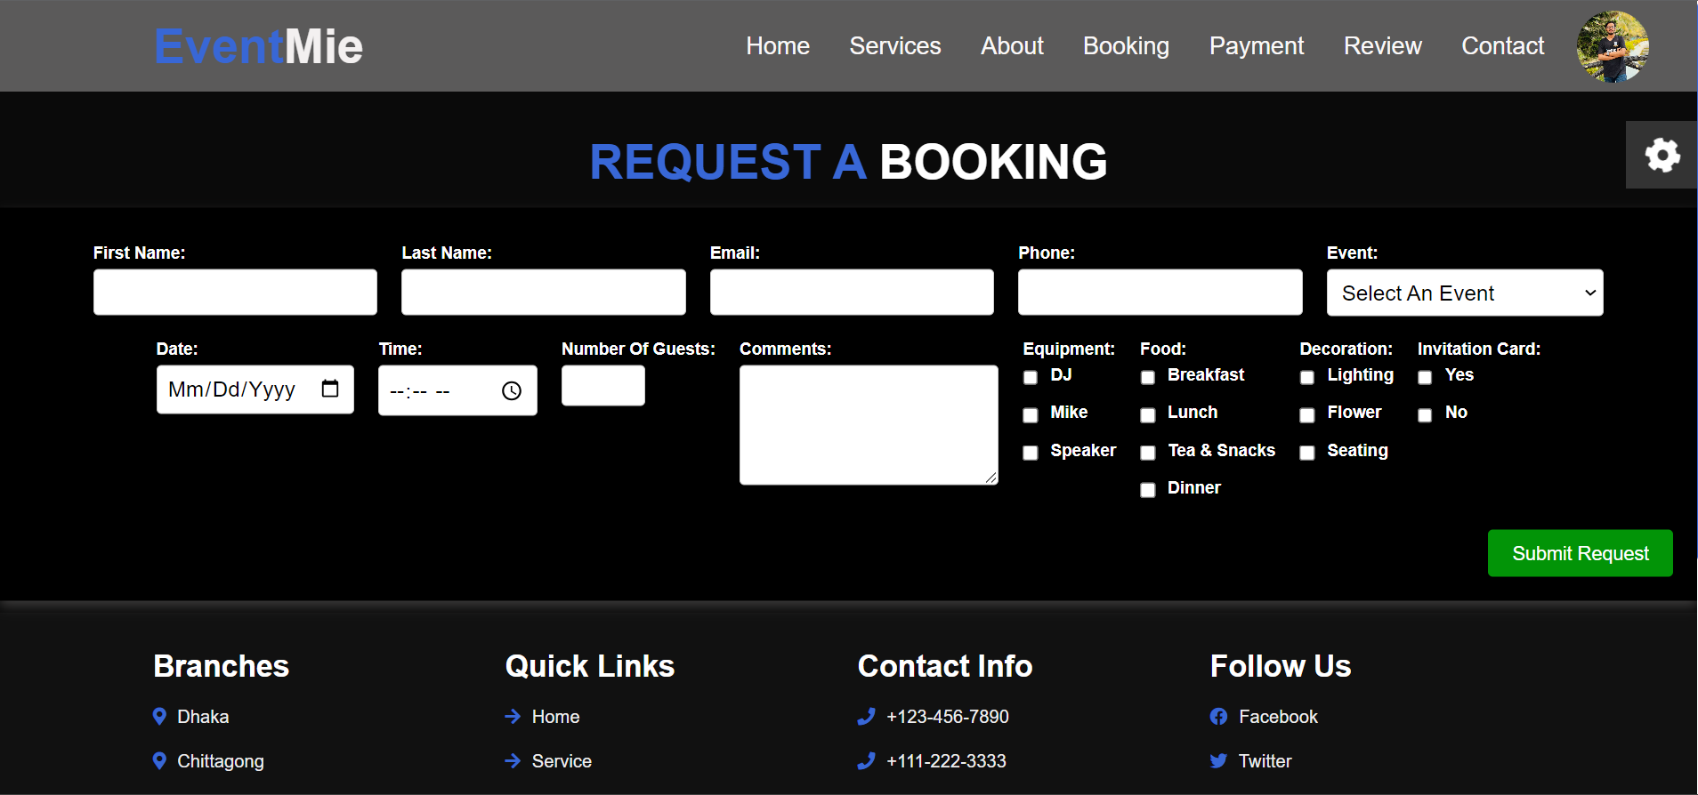
23

Slide 24
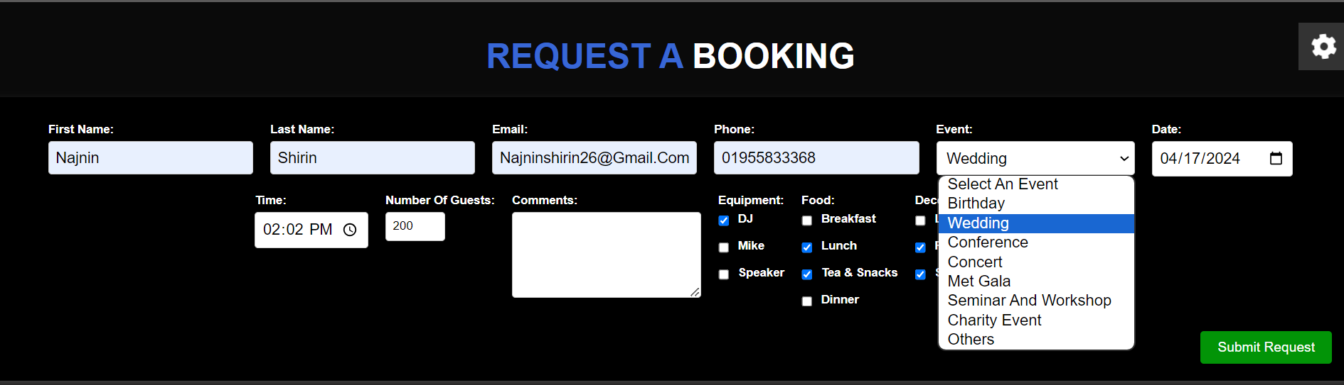
BOOKING
25

Slide 25


Team
25

Slide 26
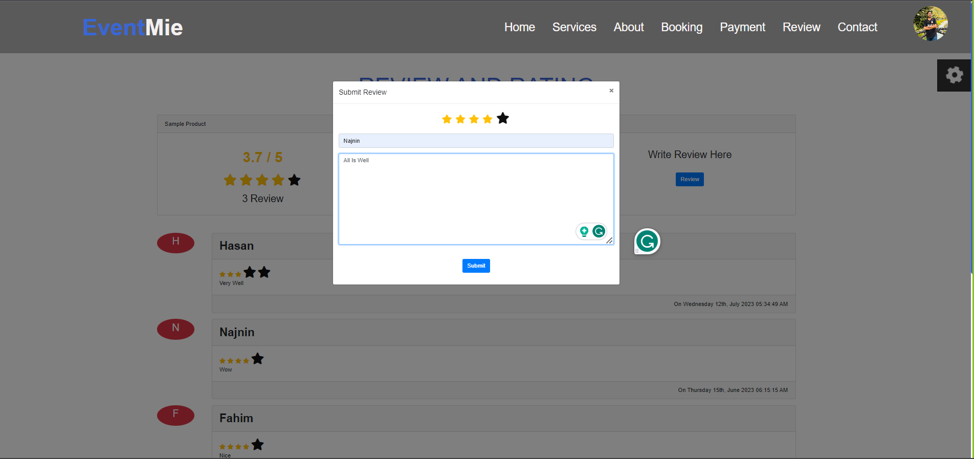
Review and rating
26

Slide 27
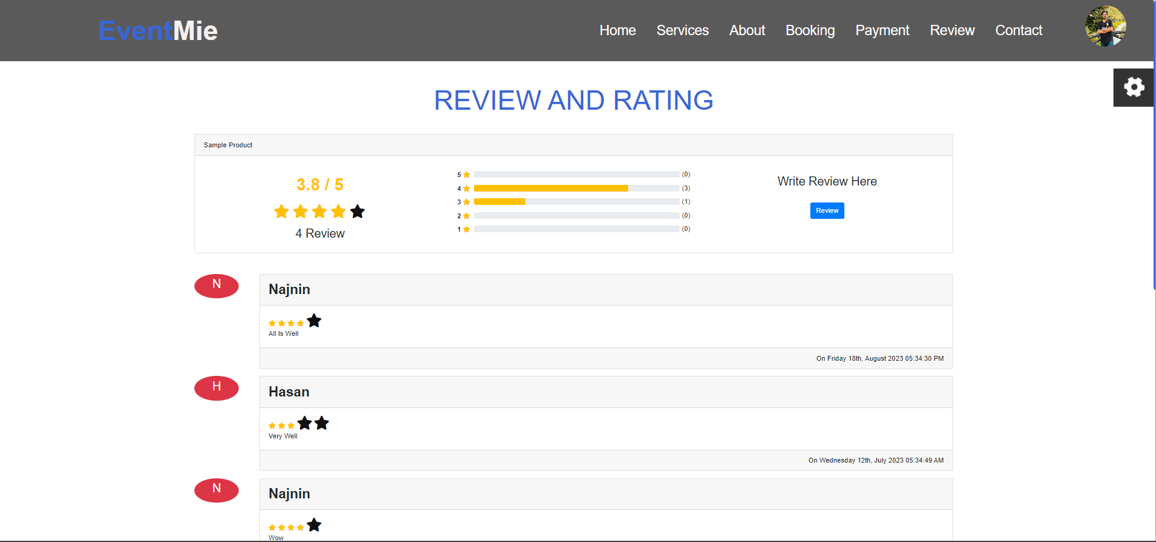
27

Slide 28
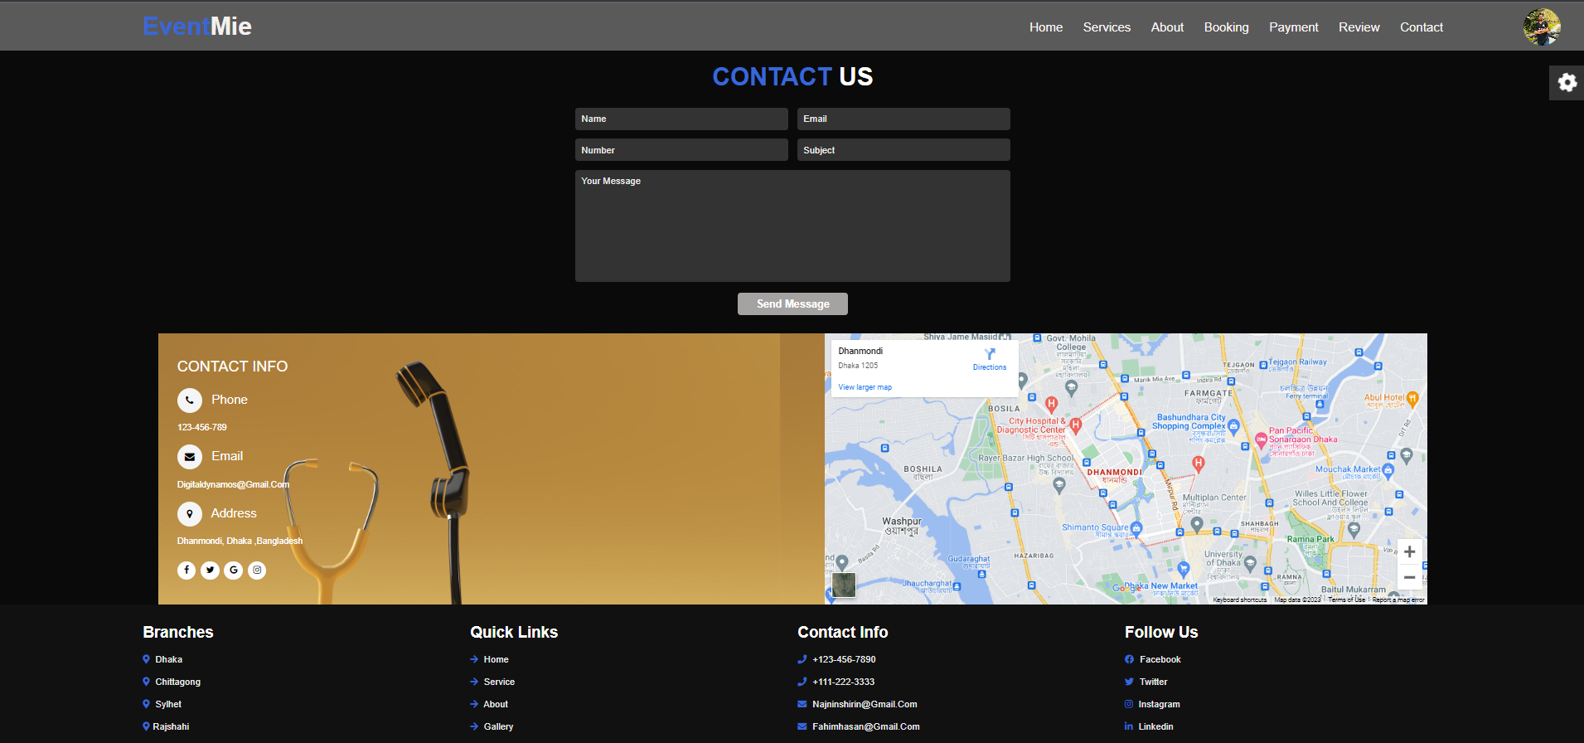
28

Slide 29
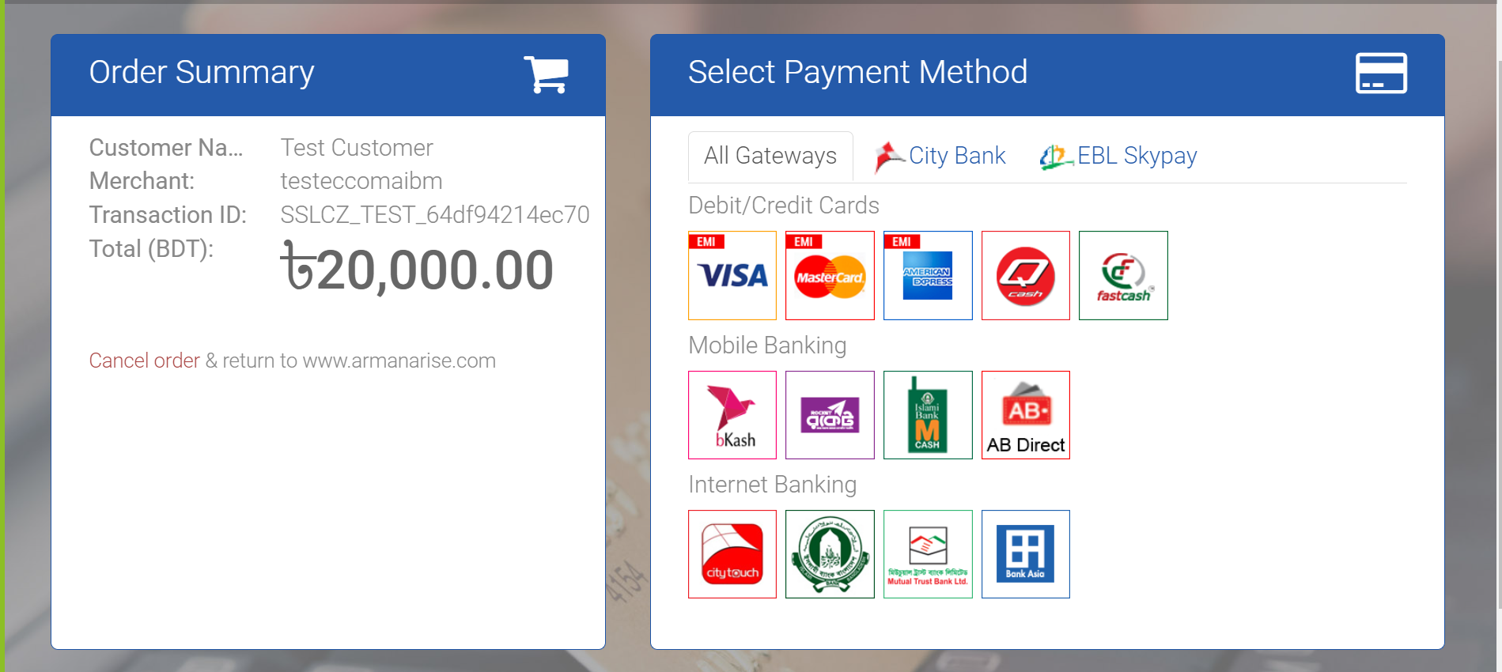
PAYMENT GATEWAY
29

Slide 30
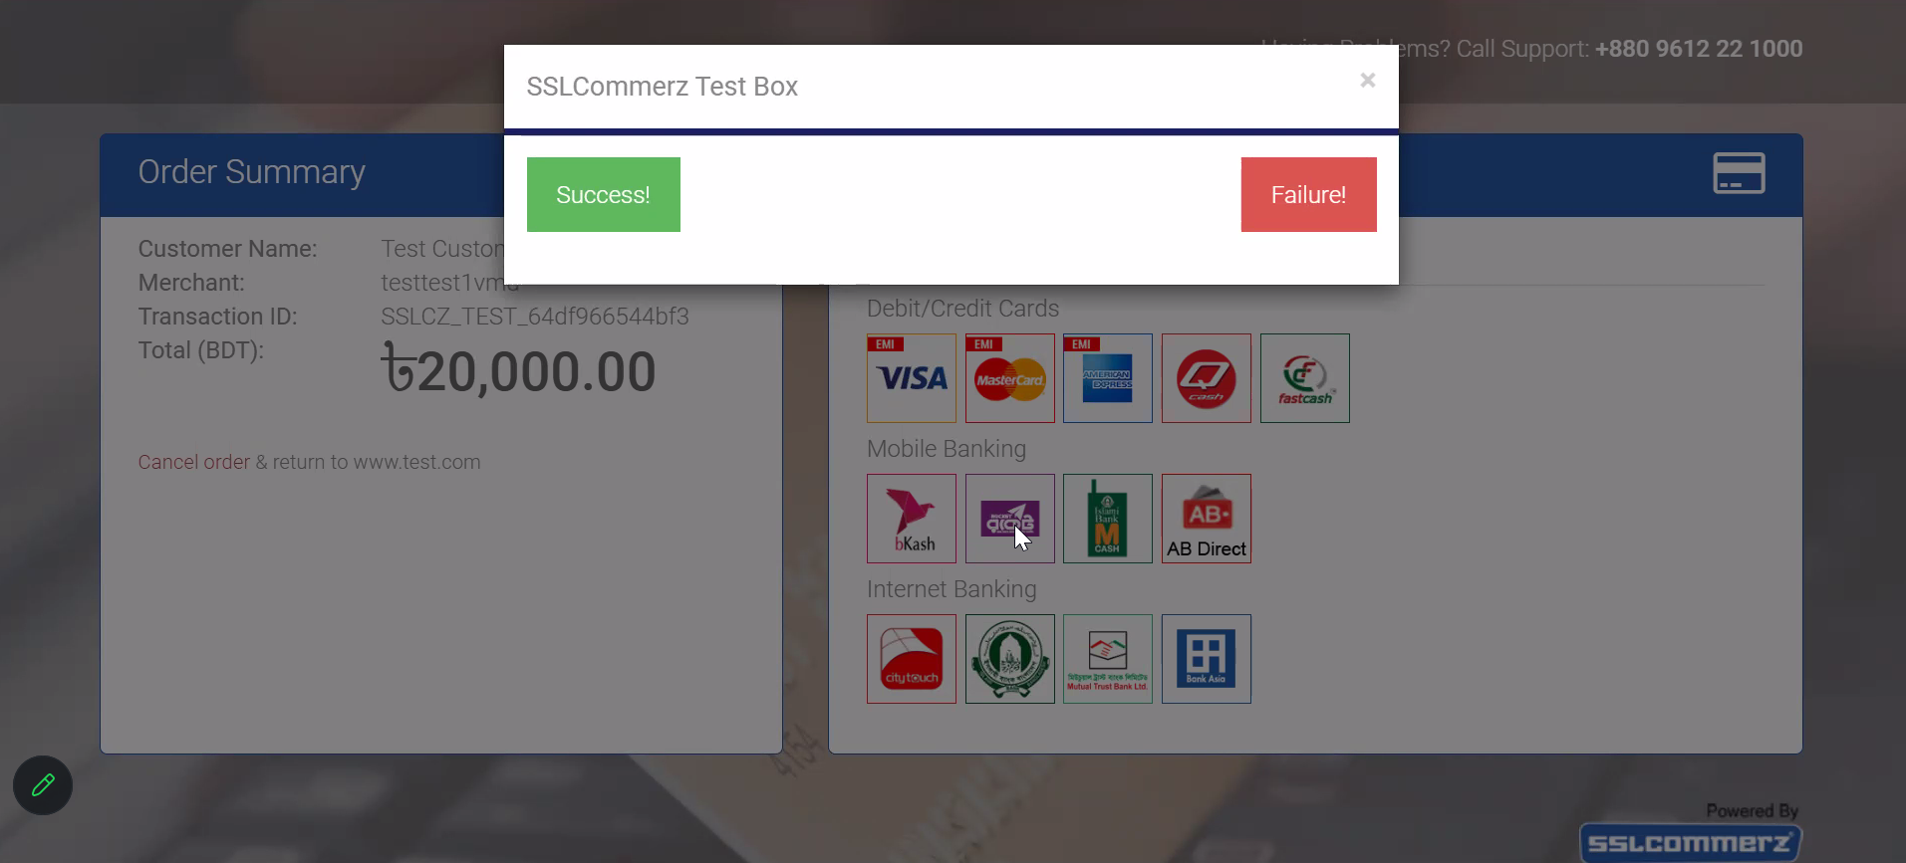
31

Slide 31
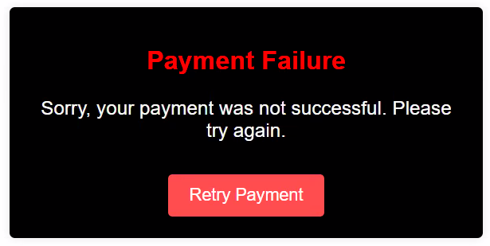
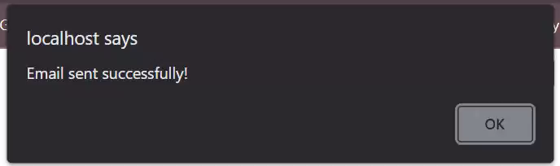
FAILURE
SUCCESS
31

Slide 32
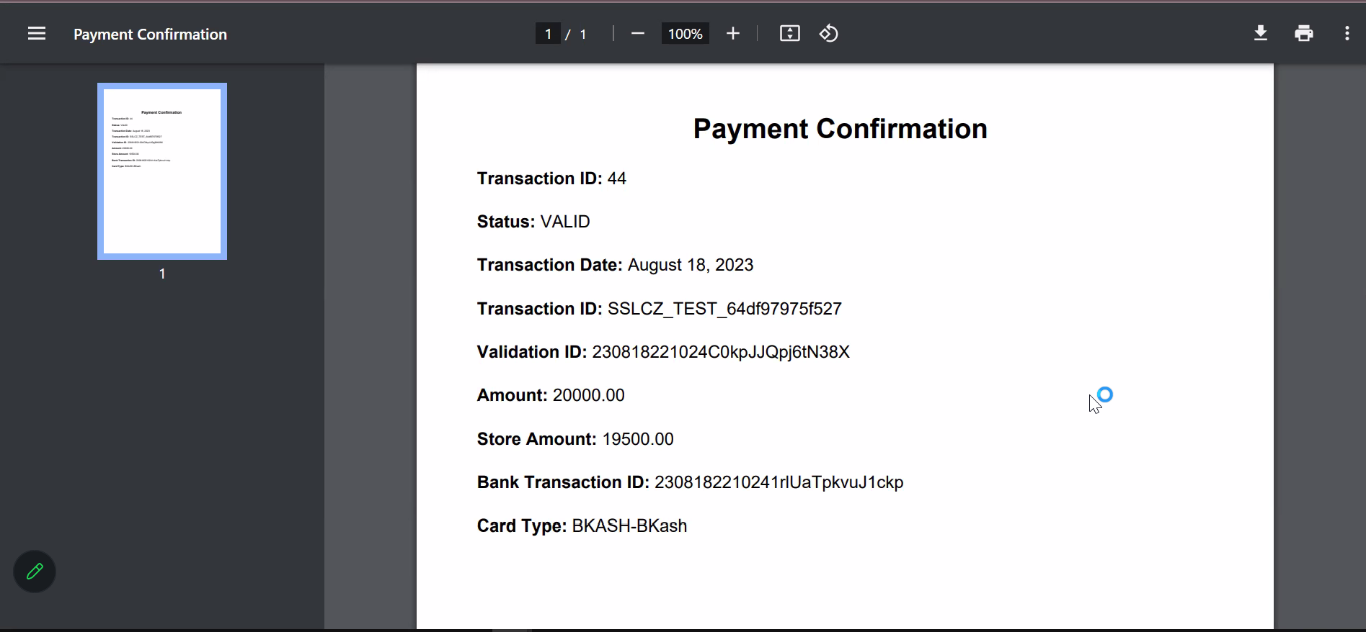
PAYMENT SCRIPT
32

Slide 33
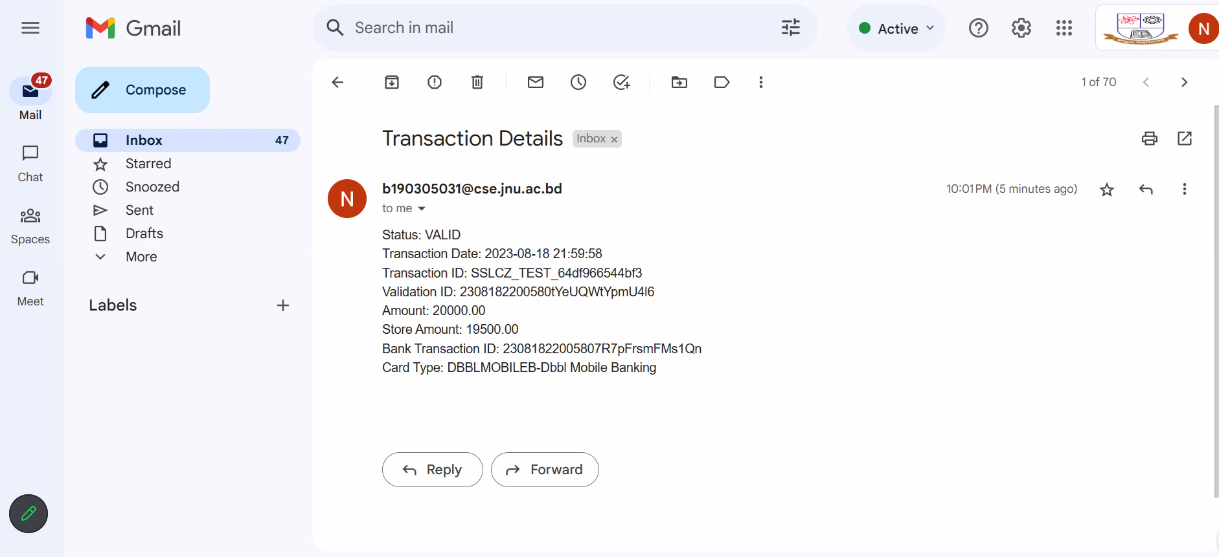
G-mail verification
33

Slide 34
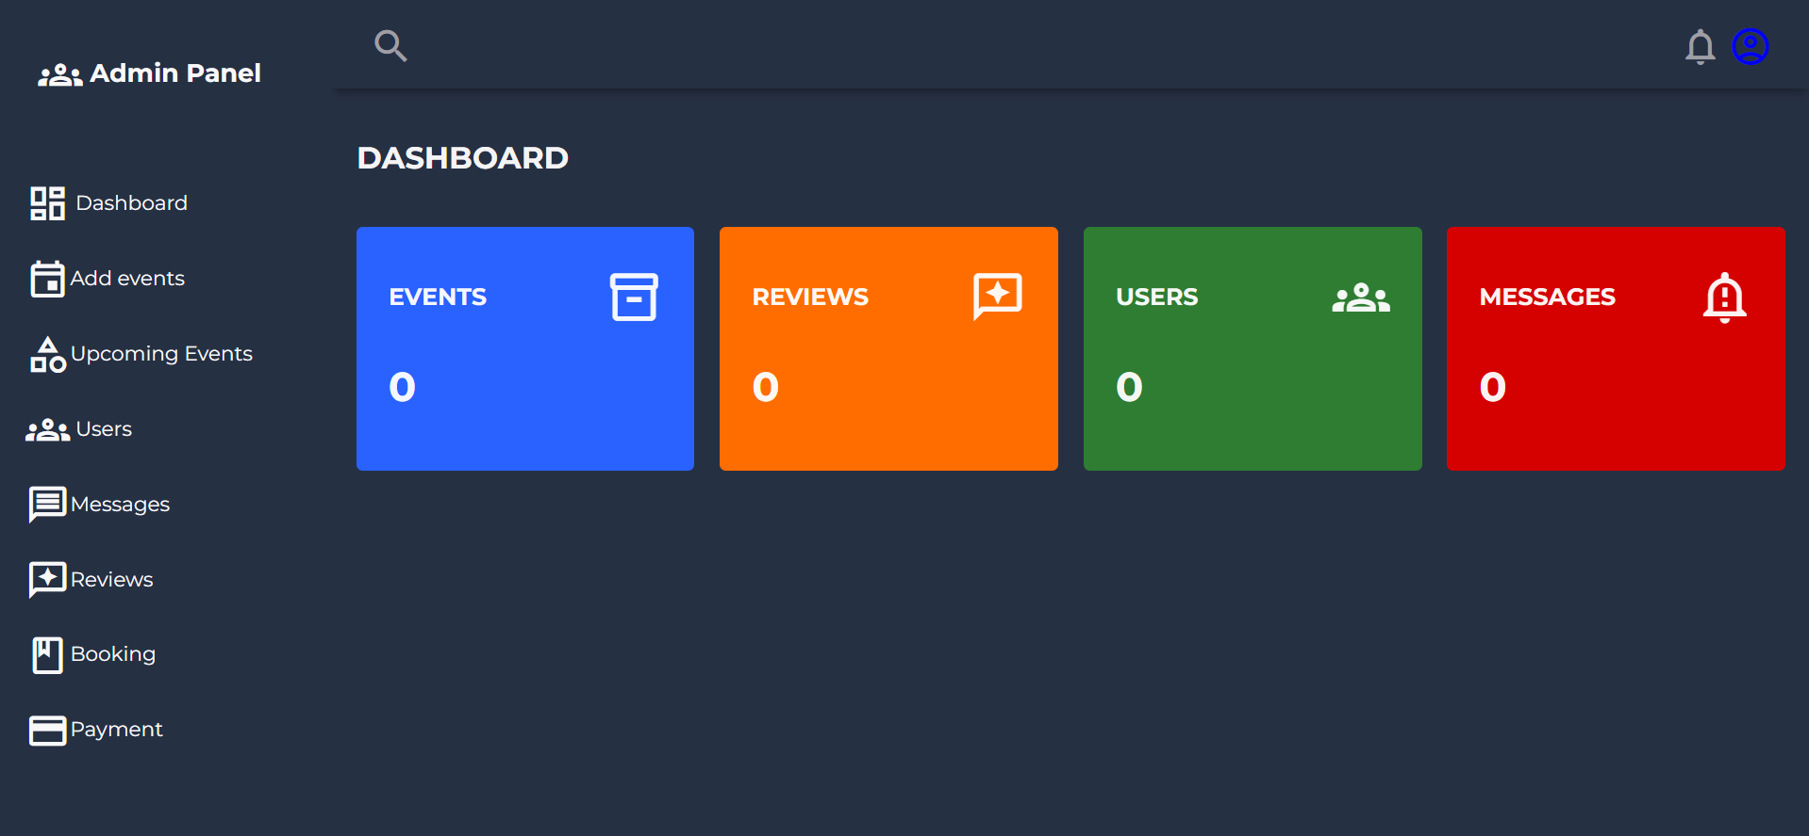
Admin panel
34

Slide 35
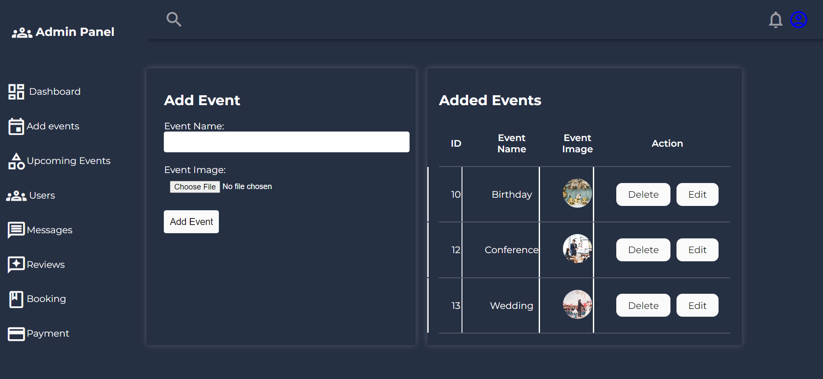
Add event
35

Slide 36
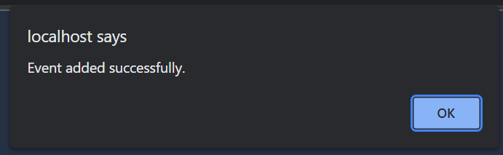
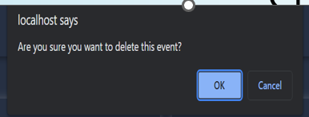
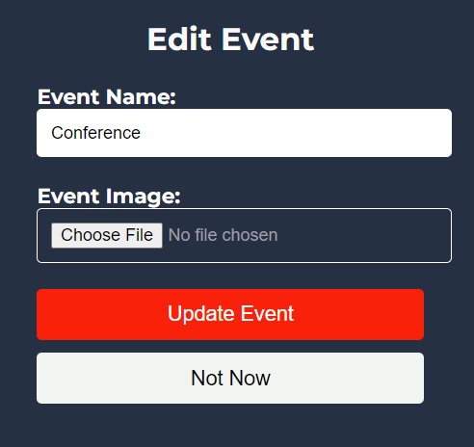
36

Slide 37
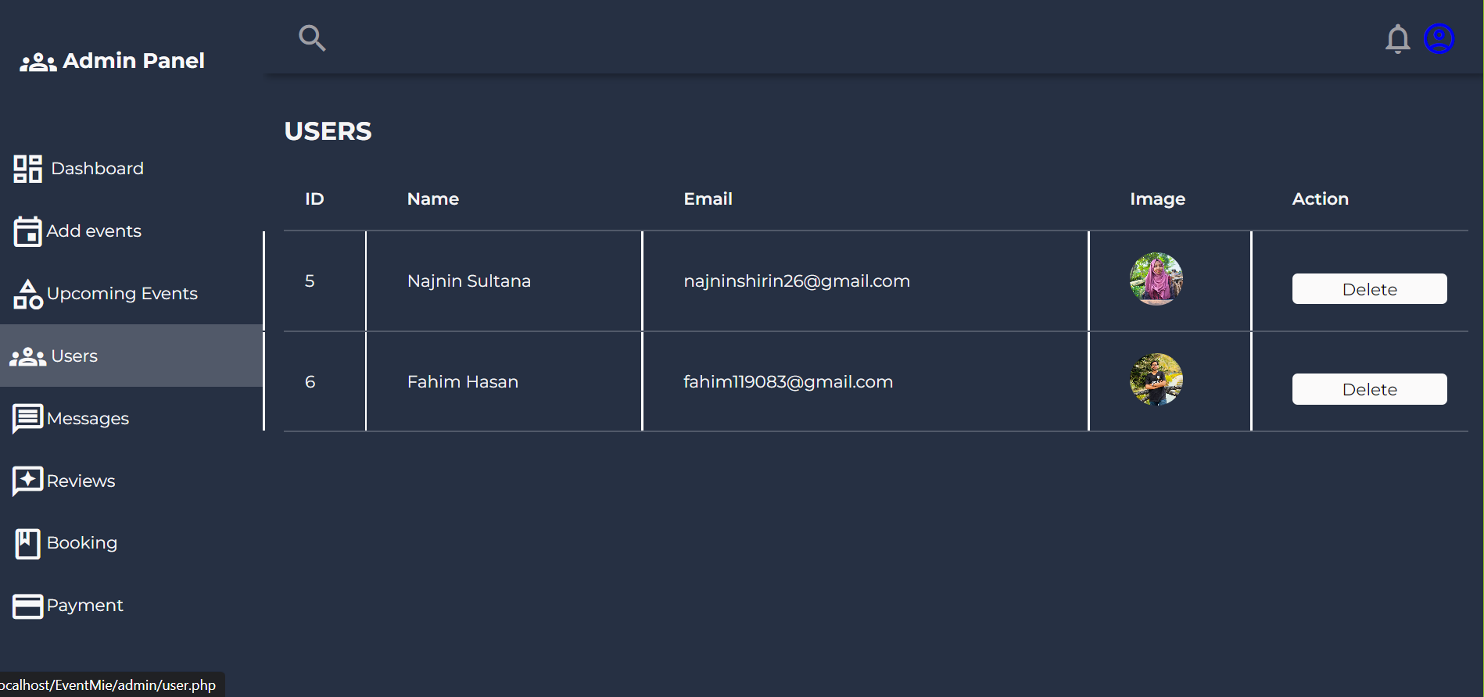
users
37

Slide 38
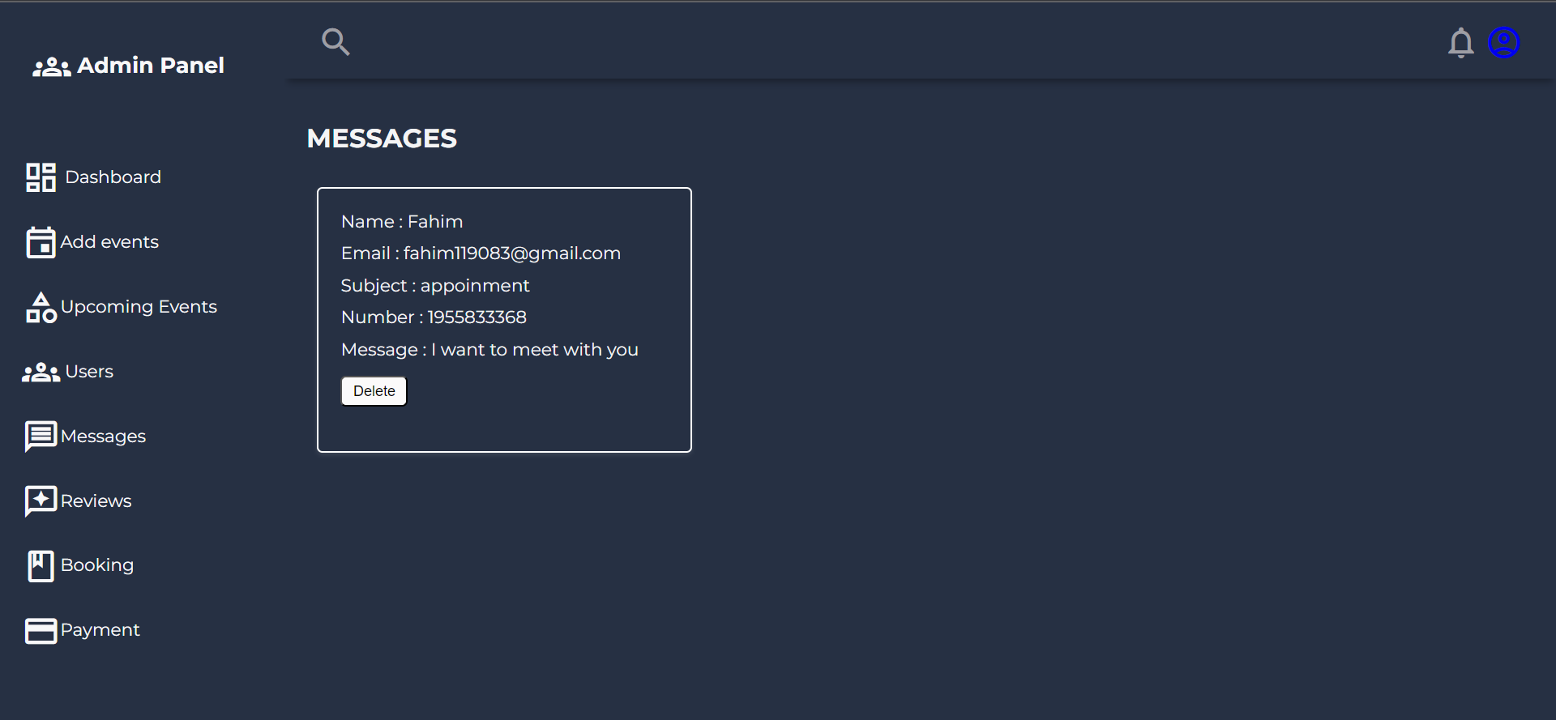
message
38

Slide 39
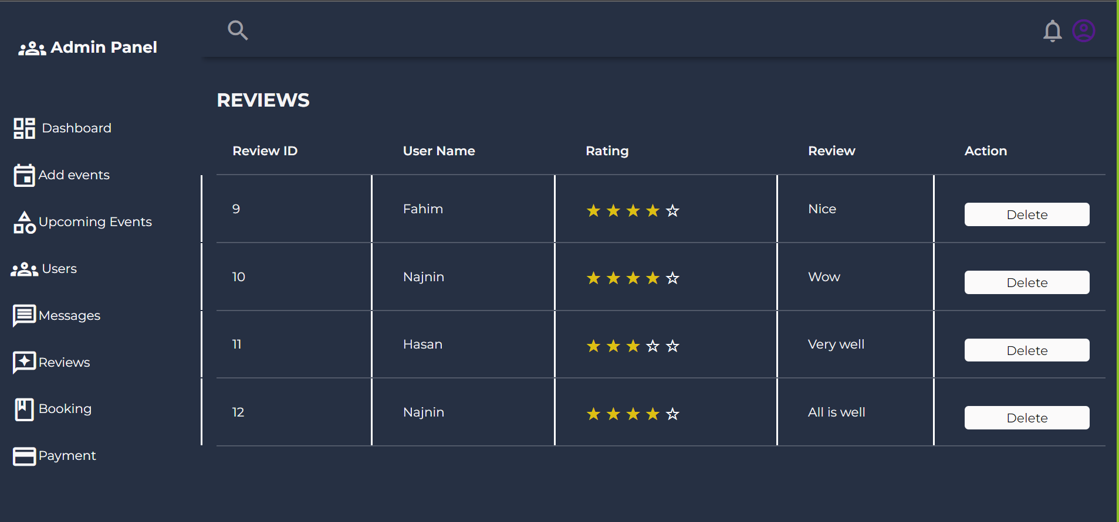
reviews
39

Slide 40
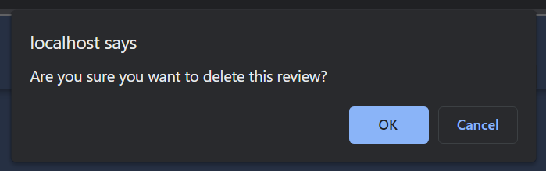
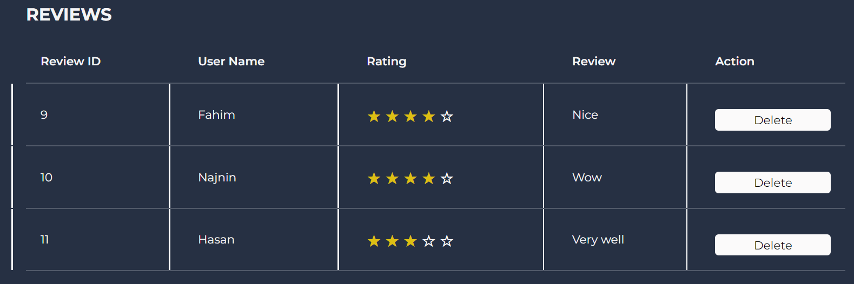
40

Slide 41
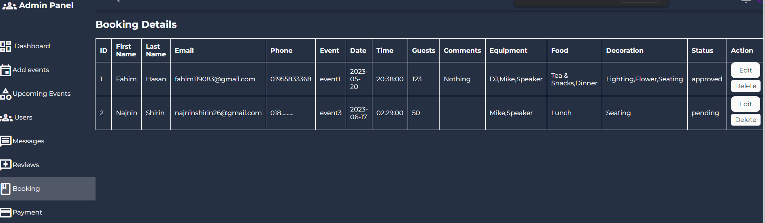
booking
41

Slide 42
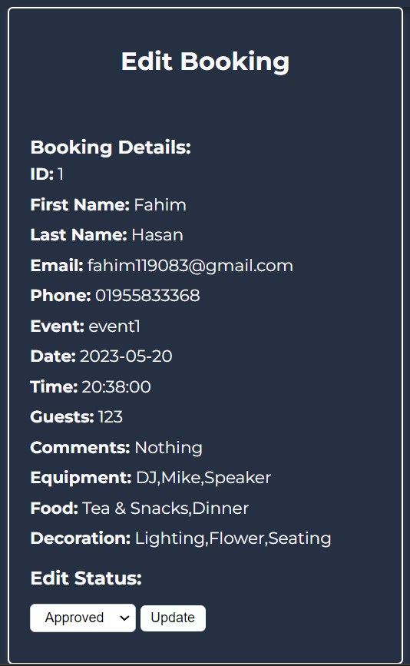
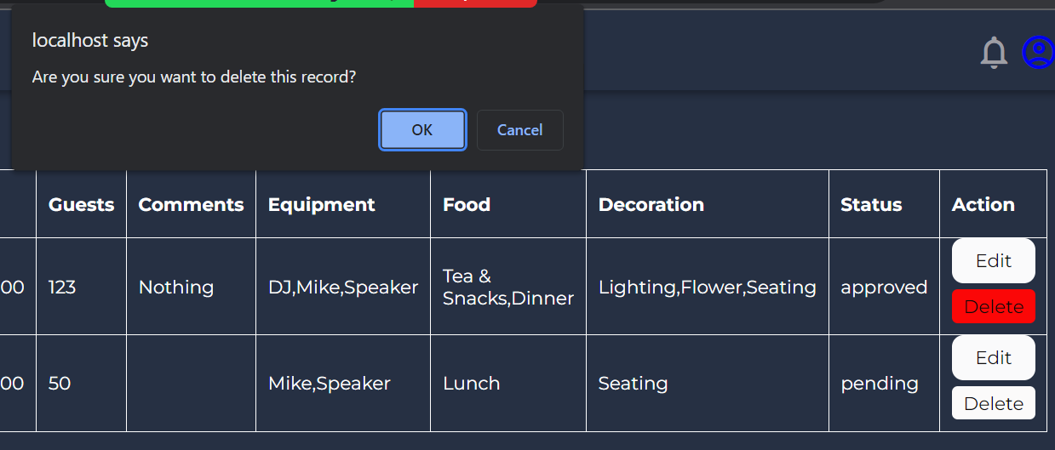
42

Slide 43
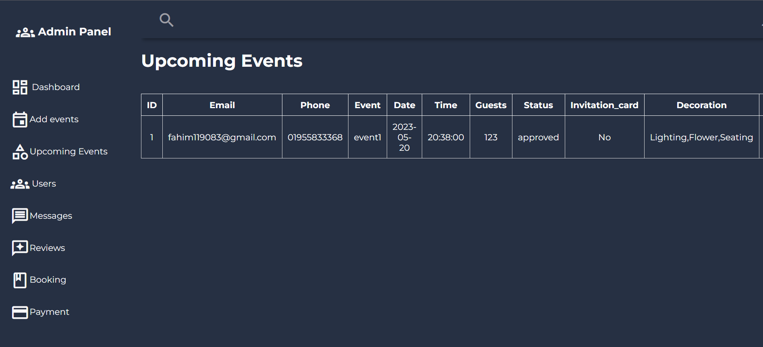
Upcoming events
43

Slide 44
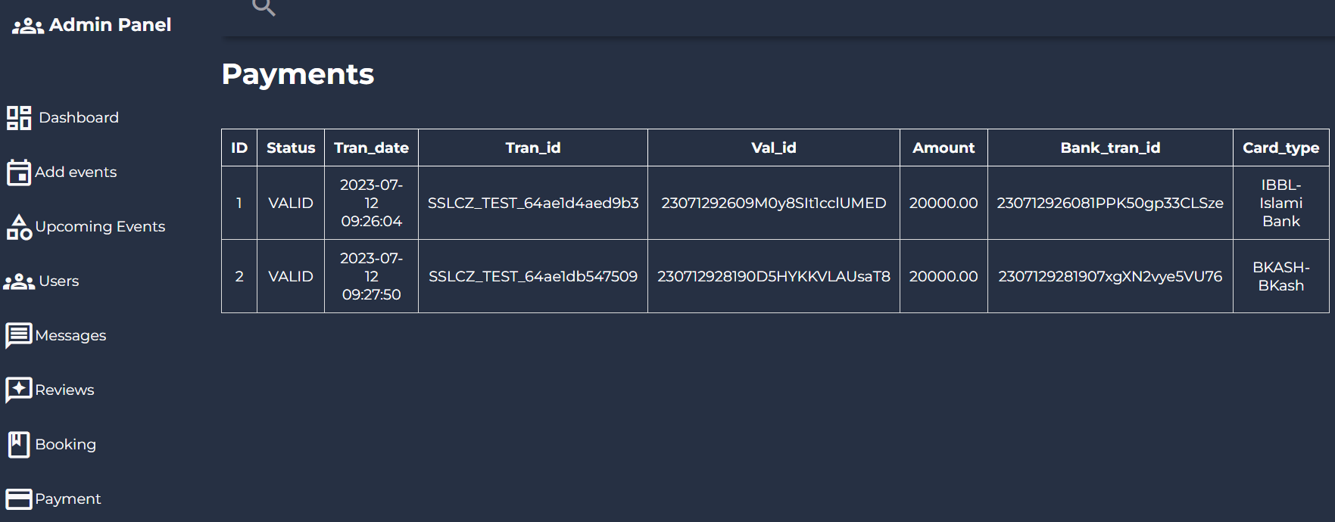
Payments details
44

Slide 45

Further implementation
In our future plans, we aspire to expand our project's scope beyond event booking. We aim to empower small organizers by providing a platform that enables them to efficiently plan and manage their events.
45

